Slide 1
JavaScript: Some Parts

Slide 2
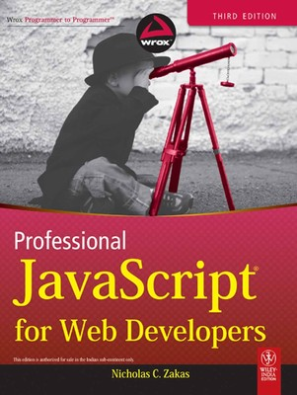
What references to use?

Slide 3
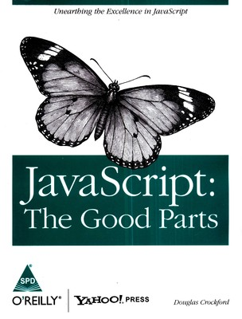
What references to use?

Slide 4
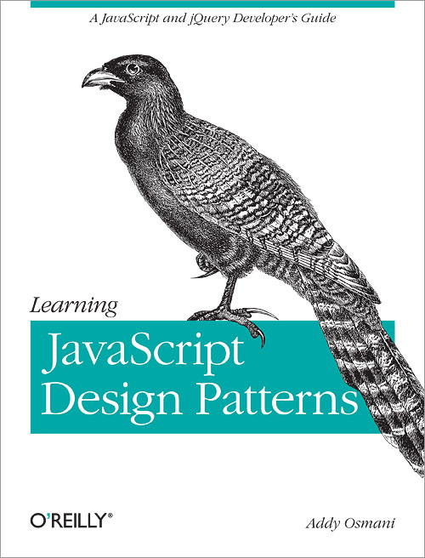
What references to use?

Slide 5
Functions

Slide 6
Functions – First Class Citizens
Can assign to a variable
Can be added as an attribute to an object
Can be passed as a parameter to a function
Can be returned from a function
[Sample Code - Functions.html]

Slide 7
Objects

Slide 8
How can we create objects?
Object Notation
Using Constructor and Prototype
[Sample Code – Objects folder]
01 - Object Notation.html
02 - Factory Pattern.html
10 - Combination Constructor Prototype Pattern.html
14 - Combination Inheritance.html

Slide 9
Any Questions?

